Slide 1
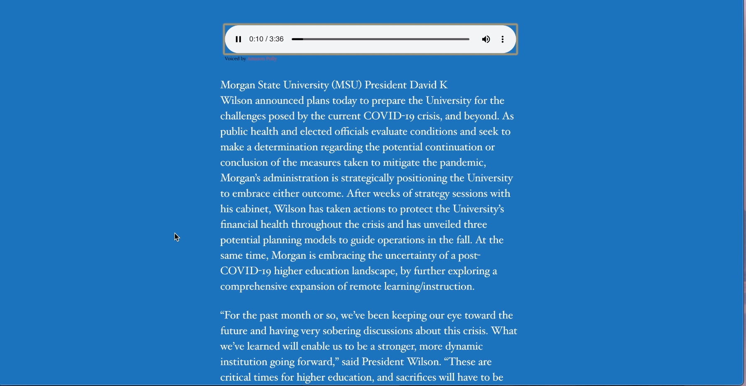
BEARantine Wordpress Site with Amazon Poly
Motivation:
With everything that is going on in the world involving this pandemic, a lot of people are searching for answers to the man questions they have. Information is provided everyday to keep the community up to date with everything that is going on in regard to COVID-19. We decided to create a “BEARantine” theme, which contains all of the COVID-19 given out to the Morgan State community.
Michael McDonald
Morgan Whitaker
Cloud Computing Final Project
Spring 2020
Abstract
For this final project, we will be attempting to load a Word Press webpage and combine it with the Amazon Polly software. Creating this project will create a site that will allow users receive hear the information on a webpage with the click of a button. Many people need this text-to-speech software in order to get through life. Sometimes it can be difficult to read things on small screens. Some people need it to listen to important documents while they are driving or multitasking. Putting the Amazon Polly plug-in on this site, will make it easier to manage and continue to add more features and additions. With its different language options, accents, and voice, it enables a user to make their text-to-speech sound a little more personalized.
Challenges
Accessing AWS features
Using Guides to help start WordPress
Adding Amazon Polly onto site
Getting information and layout to flow together
Tools Used:
Amazon AWS
WordPress
Amazon Poly

